Slide 1

FoodPantry Menu Structure

Slide 2
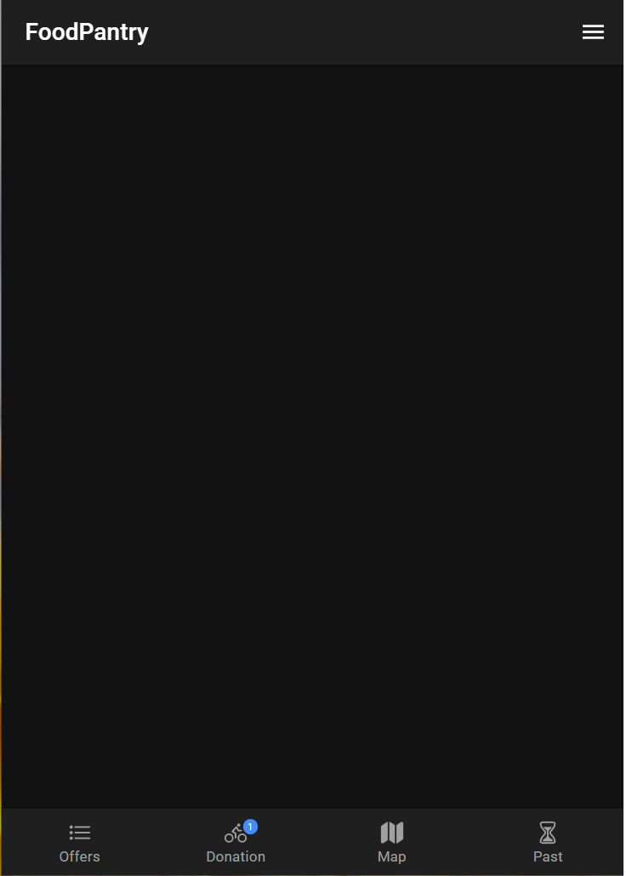
Bottom tabs navigation
Offers
Show a list of current offers the courier can sect from. For donors it shows active offers and allows to list new offer. For Receivers this tab does not display
Donation
Leads to a screen with information about current active donation in progress.
Map
Allows use of navigation and tracking of package.
Past
List of past completed or received offers. User type respective.

Slide 3
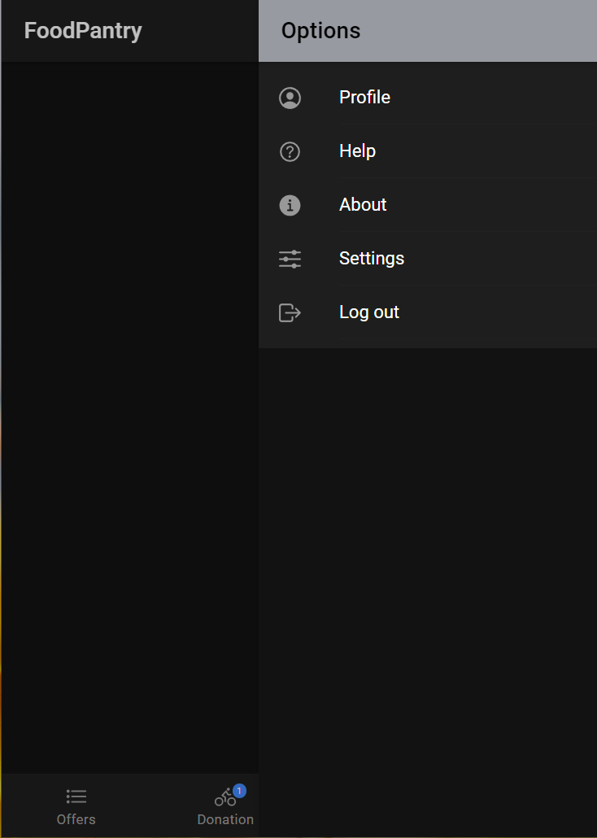
Top hamburger menu
Profile
Leads to a screen which shows user profile details. Such as name, location, etc. From there user can activate edit mode and change information if needed.
Help
Allows user to read through use case related instructions and to contact support.
About
Information about the platform and out mission statement.
Settings
Application related settings.
Log out
Allows user to sign out of the application

Slide 4
More information
Where are login and register?
As those functionalities are part of the landing screen/page and not the home screen or inner app functionality they do not appear in this presentation as is.
Implementation
The images of the menus in the presentation are screen shots of the application at the current stage of the development build.
Functionality
AS this are screen shots of development build buttons and navigation also have some of the expected functionality. Give most of the resources they lead to are not yet implemented.
Styling
The color scheme, font and overall style do not reflect there look of the finished product. They only serve as a simple placeholder to allows demonstration of the menu structure. As production goes on styling will be implemented. However, the position and functionality of the navigation is not expected to change.
Code base
Implemented with Ionic on top of ReactJS. Code is accessible through the teams GitHub project repo.

